Slide 1
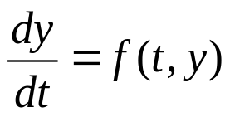

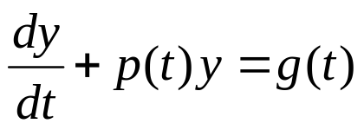
Ch 2.1: Linear Equations;
Method of Integrating Factors
A linear first order ODE has the general form
where f is linear in y. Examples include equations with constant coefficients, such as those in Chapter 1,
or equations with variable coefficients:

Slide 2




Slide 3

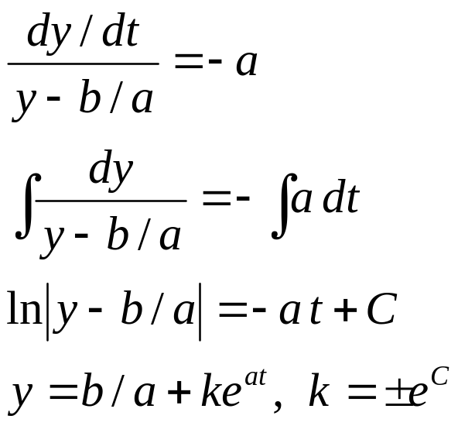
Constant Coefficient Case
For a first order linear equation with constant coefficients,
recall that we can use methods of calculus to solve:
(Integrating step)

Slide 4
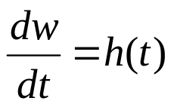
Variable Coefficient Case:
Method of Integrating Factors
We next consider linear first order ODEs with variable coefficients:
The method of integrating factors involves multiplying this equation by a function μ(t), chosen so that the resulting equation is easily integrated.
Note that we know how to integrate

Slide 5

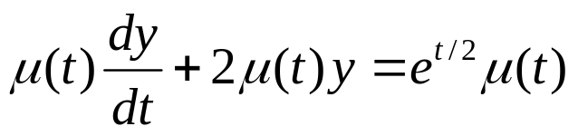
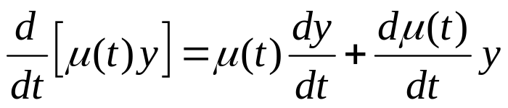

Example 1: Integrating Factor (1 of 2)
Consider the following equation:
Multiplying both sides by μ(t), we obtain
We will choose μ(t) so that left side is derivative of known quantity. Consider the following, and recall product rule:
Choose μ(t) so that (note that there may be MANY qualified μ(t) )

Slide 6




都要乘入constant term

Slide 7
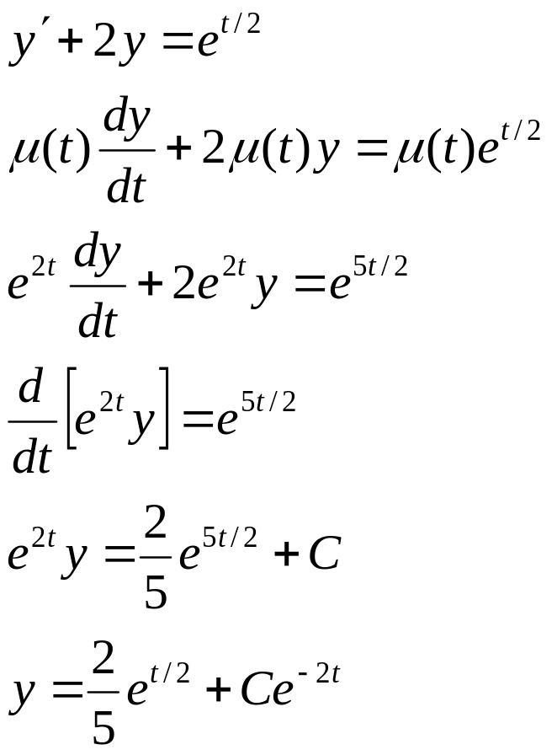
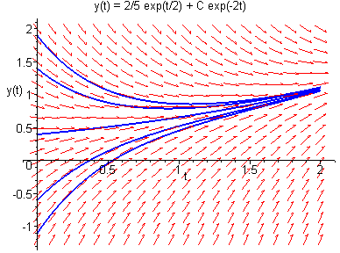
Example 1: General Solution (2 of 2)
With μ(t) = e^{2t}, we solve the original equation as follows:

Slide 8
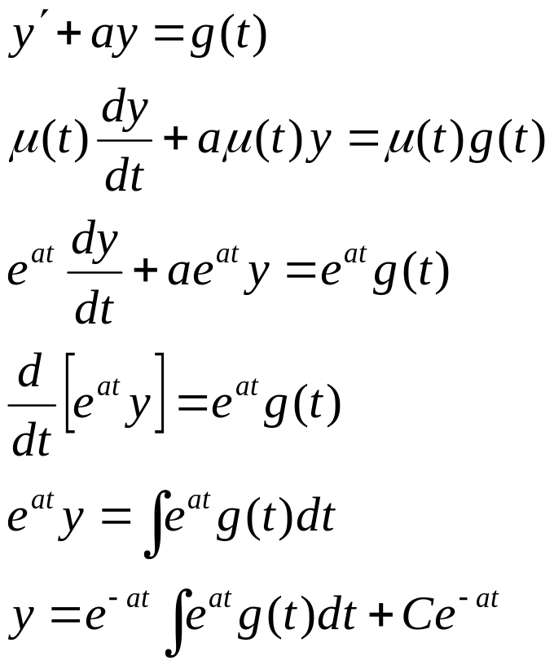
Method of Integrating Factors:
Variable Right Side
In general, for variable right side g(t), the solution can be found as follows:

Slide 9
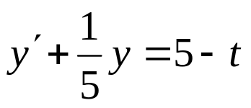
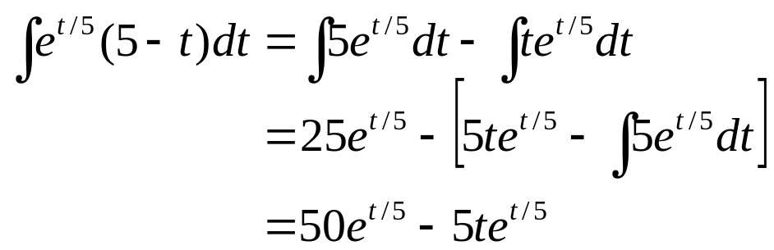
Example 2: General Solution (1 of 2)
We can solve the following equation
using the formula derived on the previous slide:
Integrating by parts,
Thus

Slide 10
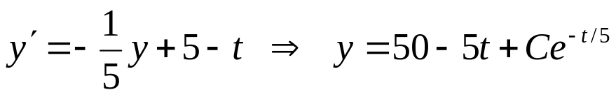
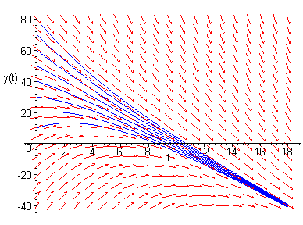
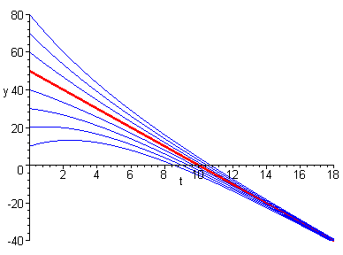
Example 2: Graphs of Solutions (2 of 2)
The graph on left shows direction field along with several integral curves.
The graph on right shows several solutions, and a particular solution (in red) whose graph contains the point (0,50).

Slide 11

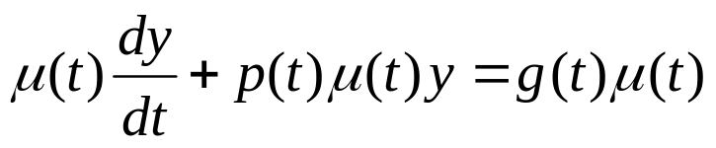
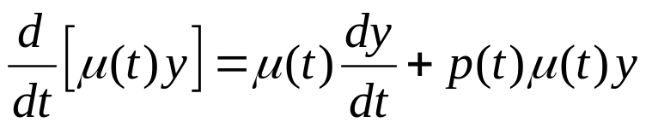
Method of Integrating Factors for
General First Order Linear Equation
Next, we consider the general first order linear equation
Multiplying both sides by μ(t), we obtain
Next, we want μ(t) such that μ'(t) = p(t)μ(t), from which it will follow that

Slide 12
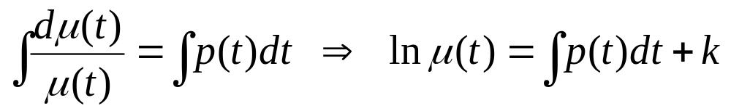
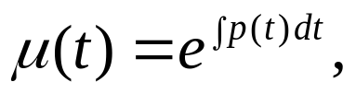
Integrating Factor for
General First Order Linear Equation
Thus we want to choose μ(t) such that μ'(t) = p(t)μ(t).
Assuming μ(t) > 0 (as we only need one μ(t) ), it follows that
Choosing k = 0, we then have
and note μ(t) > 0 as desired.

Slide 13
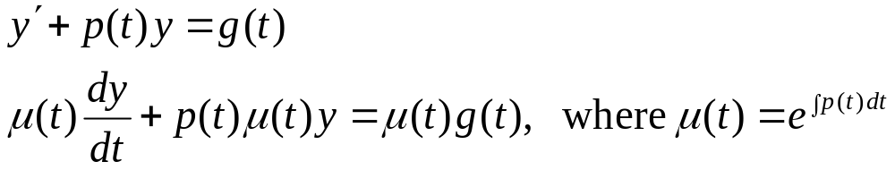
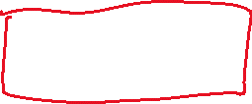

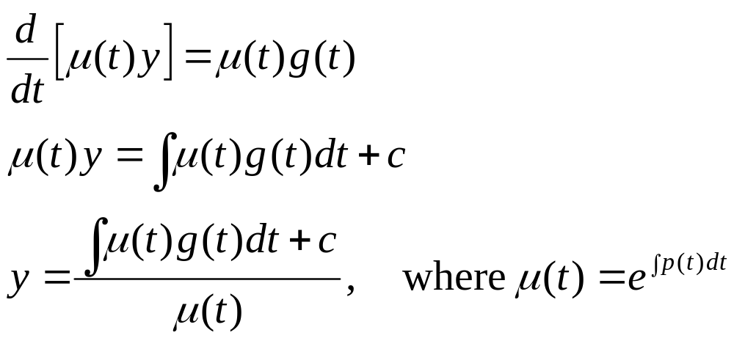
Solution for
General First Order Linear Equation
Thus we have the following:
Then

Slide 14

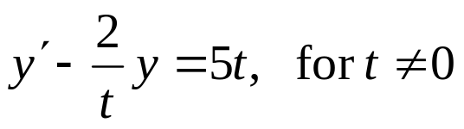
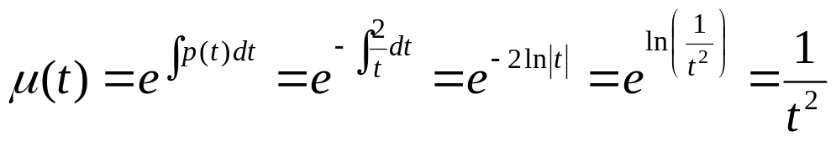
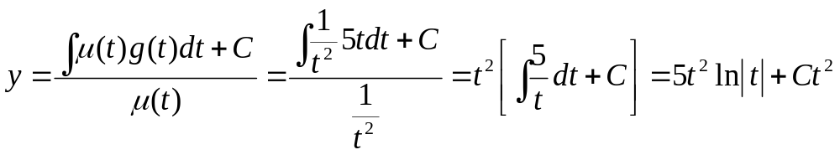
Example 4: General Solution (1 of 3)
To solve the initial value problem
first put into standard form:
Then
and hence
Note: y -> 0 as t -> 0

Slide 15
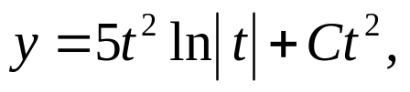


Example 4: Particular Solution (2 of 3)
Using the initial condition y(1) = 2 and general solution
it follows that
or equivalently,

Slide 16
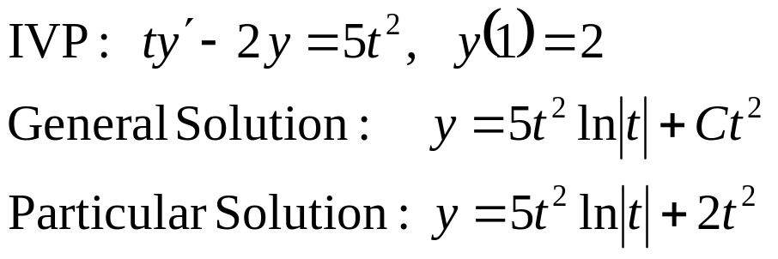
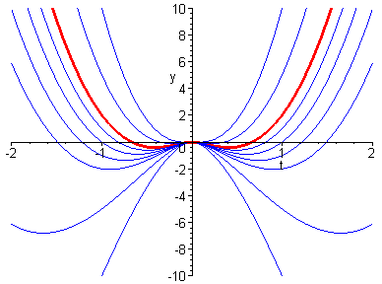
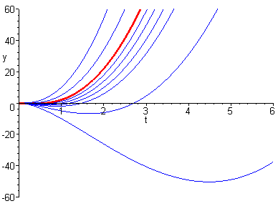
Example 4: Graphs of Solution (3 of 3)
The graphs below show several integral curves for the differential equation, and a particular solution (in red) whose graph contains the initial point (1,2).

